Slide 1

Credits & Refunds
What is the difference?

Slide 2

Purpose & Goals
TO pass on and share knowledge regarding the functionality of credits and refunds
For you to gain a solid understanding of the difference between the two concepts
For you to know what, how To use, and where to find the different functionalities associated with credits and refunds

Slide 3
Credits
Part 1

Slide 4
Credits
What Is It?
Credits are used when you need to give a customer something for free.
Credit is given for an already invoiced or paid period
Credits are applied for a future event – the next invoice period
Notes:
The important thing to note about credits is that they are given to the customer for a future period.
Example: Period of January 1 – 31 has already been invoiced, then the credit would be applied to the February 1 – 29 period.

Slide 5
Credits
Why do we need it?
the system needs a way of giving a customer ‘cash back’ that isn’t a refund
helps to correct or adjust invoices so that the customer does not get billed incorrectly

Slide 6
Credits
How does it work?
Two options:
Plug-in for automatic credits – credit for an already invoiced and paid period
create a one-time purchase order with a negative value
Notes:
Automatic Credit plug-in:
In order to create a credit using this plug in, you will need to find the original order, and change the Active Until date to something that falls within the already invoiced period. If the credit should be pro-rated, you need to enter the Cycle start date. Once you save the changes to the purchase order, the system will automatically generate a new purchase order with the negative value. When that purchase order is picked up by the billing process, the invoice will have that purchase order as a line item – a negative value for the credit. That credit amount will be deducted from the other invoice lines.
Example:
Customer purchases $100 cell phone on March 1. They are billing for the period of March 1 – 31
In order to give the customer a credit on March 14 (when they cancel), you would have to move the active until date to March 14, and a cycle start date of March 1 (if there isn’t one already). You must move the active until date within a date that has already been invoice. Since March 14 is such a date, when the purchase order is saved, you will get an automatic purchase order created with a negative value (-$100). When that order is generated onto the NEXT invoice, it will appear as a prorated amount – for the period of March 14 – 31.
The credit amount will be deducted from all other line items, and the total of the invoice will reflect that amount.
Invoice total: $150 (but you have -$100 credit)
Invoice total: $50
Create One-Time order with Negative Value:
This is explained further in example 1 and 3. Ideally, if you need a credit you can also create a one time purchase order with the negative amount (quantity or rate). This one time order will be picked up by the billing process and added to the next invoice. The manual way of generating a credit.

Slide 7
Credits
Overpayment vs. Credit
What is the difference between an overpayment and a credit?
only a credit can be negative
credit is applied as a line item on the invoice
overpayment: payment more than total of invoice
overpayment: pays down balance of other invoices
Notes:
Ask the students: Based on the information we have just reviewed, what do you think the difference between an overpayment and a credit is?
You can only have a negative purchase order for a credit, and the credit is applied as a line item on the invoice. An overpayment is when a customer makes a payment that is more than the total of the invoice. That amount can then be applied to pay down the balance of other invoices.

Slide 8
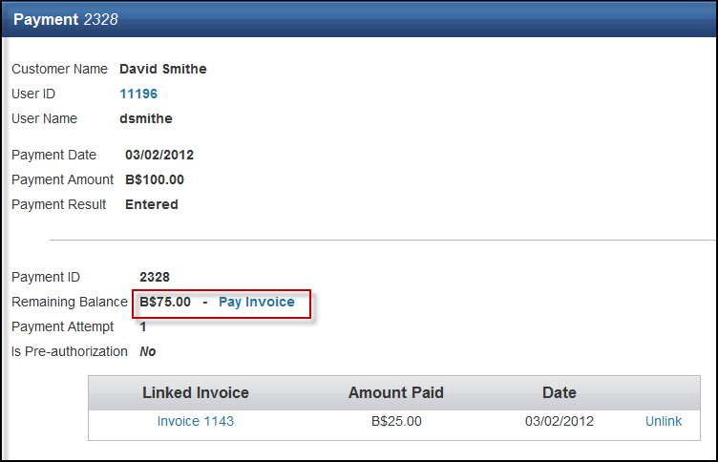
Credits
Overpayment vs. Credit
Notes:
What is this an example of? An overpayment or a credit?

Slide 9
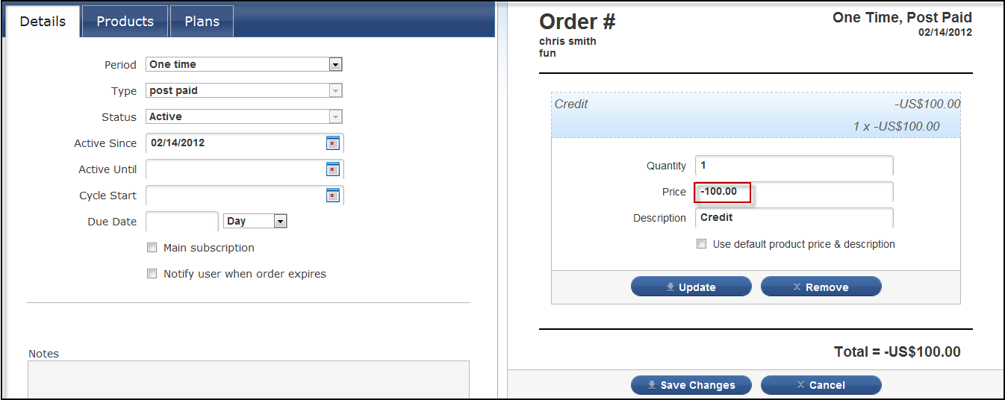
Credits
Overpayment vs. Credit
Notes:
What is this an example of? An overpayment or a credit?

Slide 10
Credits
Example 1:
T-Shirts R Us charges customer Sammy Thompson $400 every month for 400 t-shirts.
When Sammy receives his t-shirts for the month of March, he is not happy. The printing on the front does not look professional.
He has already paid for his invoice for the month of March.
Sammy calls T-Shirts R Us and complains. T-Shirts R Us lets him know that they will give him a credit for half of the t-shirts.
Notes:
This is an example of giving a credit to an invoice that has already been paid via automatic payment processor. In this example, simply deleting the invoice and adjusting the purchase order directly will not work because the customer will end up being charged twice.
T-Shirts R Us charges customer Sammy Thompson $400 every month for 400 t-shirts. When Sammy receives his t-shirts for the month of March, he is not happy. The printing on the front does not look professional. He has already paid for his invoice for the month of March. Sammy calls T-Shirts R Us and complains. T-Shirts R Us lets him know that they will give him a credit for half of the t-shirts.
Ask the students: what should you think you should do to give Sammy this credit?
In this example, we will need to create a one-time purchase order with a negative amount. When the billing process runs and the next invoice is generated for the customer, this one-time order will be picked up and the credit will be applied to the invoice.

Slide 11

Credits
Example 1:
Sammy Thompson
March 1 - 31
400 T-Shirts - $400.00
Total: $400
Notes:
This is an example of giving a credit to an invoice that has already been paid via automatic payment processor. In this example, simply deleting the invoice and adjusting the purchase order directly will not work because the customer will end up being charged twice.
T-Shirts R Us charges customer Sammy Thompson $400 every month for 400 t-shirts. When Sammy receives his t-shirts for the month of March, he is not happy. The printing on the front does not look professional. He has already paid for his invoice for the month of March. Sammy calls T-Shirts R Us and complains.

Slide 12

Credits
Example 1:
Sammy Thompson
April 1 - 30
400 T-Shirts: $400.00
T-Shirt Credit: -$200.00
Total: $200
Notes:
T-Shirts R Us lets him know that they will give him a credit for half of the t-shirts.
Ask the students: what should you think you should do to give Sammy this credit?
In this example, we will need to create a one-time purchase order with a negative amount. When the billing process runs and the next invoice is generated for the customer, this one-time order will be picked up and the credit will be applied to the invoice. (Demonstrate this in jBilling).
Ask the students: what will his next invoice look like?
Answer: He will be charged for $200 (400 t-shirts subtract 200 t-shirts: $400 - $200 = $200)

Slide 13
Credits
Example 1 Solution:
Create one-time purchase order with negative amount of: 200 t-shirts (-200)
Save the purchase order
Leave it to be picked up on the next invoice (April)
Notes:
Ask the students: what should you think you should do to give Sammy this credit?
In this example, we will need to create a one-time purchase order with a negative amount. When the billing process runs and the next invoice is generated for the customer, this one-time order will be picked up and the credit will be applied to the invoice. (Demonstrate this in jBilling).
Ask the students: what will his next invoice look like?
Answer: He will be charged for $200 (400 t-shirts subtract 200 t-shirts: $400 - $200 = $200)

Slide 14
Credits
Example 2:
Box it up sells boxes to Sarah Todd. Sarah Todd started Pre-paying for her monthly charges of $600 on January 1.
She receives her first invoice on for the period of January immediately. Then she receives her second invoice for February on February 1. Both invoices are paid (pre-paid).
Sarah decides on February 14 that she no longer needs the boxes.
Notes:
Let’s take a look at a different example:
Box It Up sells boxes to Sarah Todd. Sarah Todd started pre-paying for her monthly charges of $600 on January 1.
She receives her January invoice, and then receives her February invoice. Both are paid. Sarah decides on February 14 that she wants to cancel her subscription for these boxes.
Ask the students: What do you think you should do to give Sarah her credit?
Answer: you need to edit the purchase order. We are using the Automatic Credit plug-in, therefore we need to change or enter an active since date that falls in the period that has already been invoiced.
Ask: Which period has already been invoiced?
Answer: January and February
Ask: Which period do we want a credit for?
Answer: February 14 – 28 (29)
Ask: What should we set the active until date to? Answer: February 14. This is the date that Sarah wants to cancel the services on.
Demonstrate: Set up this purchase order in jBilling
1. Active Since: Jan 1
2. Generate an invoice and pay the invoice manually
3. Generate another invoice for the February period – pay invoice
4. Edit the purchase order – enter the active until date of February 14. We also need the cycle start date because this credit will be prorated. Cycle start should be: February 1 because we want the system to look from Feb 1 – 28 (29) when calculating the period.
5. When you save the purchase order, the system will automatically generate a purchase order with the full amount of the credit. When that credit is generated into an invoice, the amount will reflect the period (in this case you will get a pro-rated credit amount for the period of February 14 – 28 (29)).
6. Explain that when the billing process runs next, and there are other purchase orders that the billing process sees, this credit will be generated onto the invoice, and the credit amount will be deducted from the total of the invoice.
NOTE: It is important to note that Sarah would still need to be receiving other services in order to get this credit applied to her next invoice, otherwise this example would be a refund.

Slide 15

Credits
Example 2:
Sarah Todd
January 1 - 31
400 Boxes- $600.00
Total: $600
Sarah Todd
February 1 -29
400 Boxes- $600.00
Total: $600
Notes:
Let’s take a look at a different example:
Box It Up sells boxes to Sarah Todd. Sarah Todd started pre-paying for her monthly charges of $600 on January 1.
She receives her January invoice, and then receives her February invoice. Both are paid. Sarah decides on February 14 that she wants to cancel her subscription for these boxes.
Ask the students: What do you think you should do to give Sarah her credit?
Answer: you need to edit the purchase order. We are using the Automatic Credit plug-in, therefore we need to change or enter an active since date that falls in the period that has already been invoiced.
Ask: Which period has already been invoiced?
Answer: January and February
Ask: Which period do we want a credit for?
Answer: February 14 – 28 (29)
Ask: What should we set the active until date to? Answer: February 14. This is the date that Sarah wants to cancel the services on.
Demonstrate: Set up this purchase order in jBilling
1. Active Since: Jan 1
2. Generate an invoice and pay the invoice manually
3. Generate another invoice for the February period – pay invoice
4. Edit the purchase order – enter the active until date of February 14. We also need the cycle start date because this credit will be prorated. Cycle start should be: February 1 because we want the system to look from Feb 1 – 28 (29) when calculating the period.
5. When you save the purchase order, the system will automatically generate a purchase order with the full amount of the credit. When that credit is generated into an invoice, the amount will reflect the period (in this case you will get a pro-rated credit amount for the period of February 14 – 28 (29)).
6. Explain that when the billing process runs next, and there are other purchase orders that the billing process sees, this credit will be generated onto the invoice, and the credit amount will be deducted from the total of the invoice.
NOTE: It is important to note that Sarah would still need to be receiving other services in order to get this credit applied to her next invoice, otherwise this example would be a refund.

Slide 16
Credits
Example 2 Solution:
Create order for Sarah – active since Jan 1
Generate invoice for Jan 1 – 31 period – pay invoice
Generate second invoice for Feb 1 – 29 period – pay invoice
Edit purchase order: Active Until February 14
Edit cycle start date: February 1
Save purchase order – automatic credit created
Notes:
Demonstrate: Set up this purchase order in jBilling
1. Active Since: Jan 1
2. Generate an invoice and pay the invoice manually
3. Generate another invoice for the February period – pay invoice
4. Edit the purchase order – enter the active until date of February 14. We also need the cycle start date because this credit will be prorated. Cycle start should be: February 1 because we want the system to look from Feb 1 – 28 (29) when calculating the period.
5. When you save the purchase order, the system will automatically generate a purchase order with the full amount of the credit. When that credit is generated into an invoice, the amount will reflect the period (in this case you will get a pro-rated credit amount for the period of February 14 – 28 (29)).
6. Explain that when the billing process runs next, and there are other purchase orders that the billing process sees, this credit will be generated onto the invoice, and the credit amount will be deducted from the total of the invoice.

Slide 17
Credits
Example 3:
This is the purchase Order:
The customer has already paid for the January 1 – 31 period.
What would you need to do in order to give the customer a credit only for the text message product?
Frank Davids
Active Since: January 1
4000 Minutes - $600.00
Cell Phone - $200.00
500 Text Messages - $50
Notes:
Answer: You would have to create a one time purchase order with the negative amount of $200. The next time the billing process runs, it will be applied to the next invoice.
What if the customer wanted a credit because they ordered the wrong items? They ask for this credit on January 24.
Answer – this would be a case where you create an automatic refund. Enter an Active Until date of January 24.

Slide 18
Refunds
Part 2

Slide 19
Refunds
What Is It?
Is given to a customer when they are cancelling their services with the company, have already paid for their invoice, and require money back
A refund occurs for something that has been made in the past: a payment.

Slide 20
Refunds
Why do we need it?
There are instances where a customer will cancel all services with a company, but have already paid for the invoice.
The customer will expect to be reimbursed for the services that they paid for, but did not use.

Slide 21
Refunds
How does it work?
a refund can only be made for a payment that has already been paid (in the past)
choose the payment that is to be refunded
click on the ‘refund payment’ checkbox, you are able to create a payment that indicates you are giving money back to the customer
Refund cannot exceed payment balance
Notes:
Note: Currently the system will only allow you to make a refund in full. If the invoice was $100, then the refund will need to be $100. There is no way to make a partial refund.

Slide 22
Refunds
Example 1:
Brian Smith Cancels his services with Telecall Systems.
He has already paid for his last invoice ($100), Telecall Systems needs to provide him with a refund.
Notes:
Brian Smith cancels his services with telecall systems. Because he has already paid for his invoice, ($100) telecall systems needs to send him a refund.

Slide 23
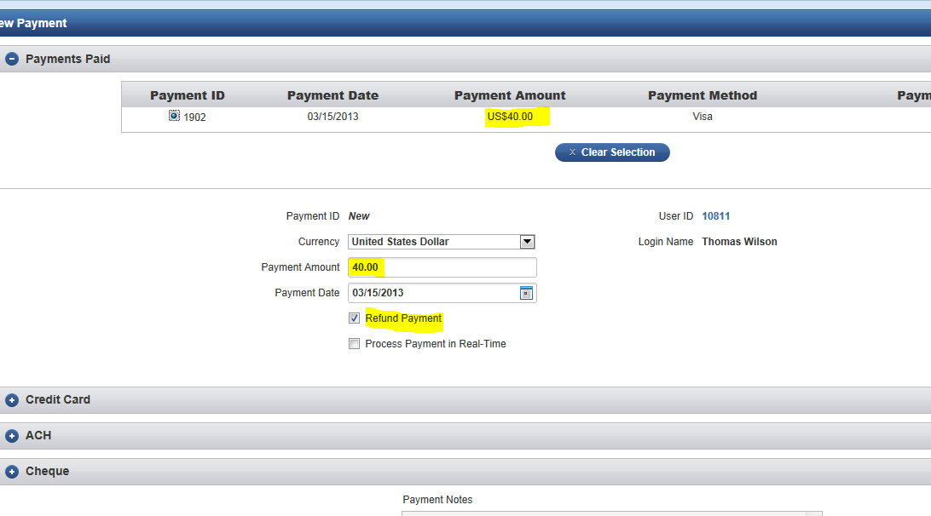
Original Payment Involved
Example 1:
Notes:
Find the invoice that the payment was made on, select the ‘Pay Invoice’ button. OR ‘Make Payment’ button on customer screen.
Enter the amount that you wish to refund and ensure that the Refund Payment checkbox is selected (in this example, we want to refund Brian $100). Proceed with the payment as you normally would. The payment should be recorded as a ‘Refund’ instead of payment under the payment and refunds tab.
The amount will appear as a negative value in the customer’s account, and it is up to the company (Telecall in this instance) to provide Brian with the payment. Remember, you only give a customer a refund when they are cancelling all their services – they no longer want to purchase items from Telecall Systems for example. Otherwise, you would want to create a credit.
Demonstrate this in jBilling: Set up customer Brian Smith
Create a purchase order, generate an invoice
Pay the invoice
Create a refund for the customer – enter payment amount and Refund Payment checkbox is selected.

Slide 24
Orders Involved
Example 2:
Thomas Wilson pre-paid for his August invoice ($500).
On August 1, he no longer wants to purchase any items from television world
Notes:
Thomas pre-paid for his August invoice, and on August 1st decides he no longer wants to purchase any items from Television World.

Slide 25
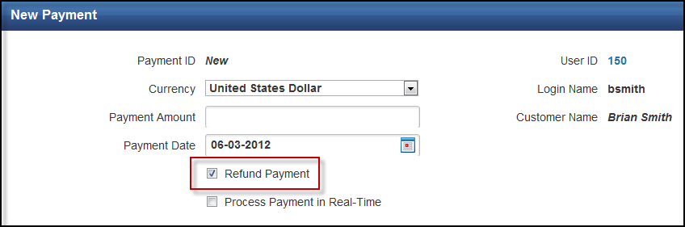
Orders Involved
Example 2:
Notes:
Ask the Students: What do you need to do in this situation, to get Thomas his refund? –
What is the payment amount for this refund? ($500)
What else needs to be selected in order to let the system know that his amount should be refunded? (Select the refund payment checkbox, or select a payment paid.)

Slide 26
Orders Involved
Example 3:
Credit or refund?
1. An invoice is sent to Tammy with a quantity of 25 ladders. Tammy calls and says she only wanted 20 ladders for the first month, then 25 after that.
2. Graham pre-pays for his July invoice. He decides he no longer wants to continue purchasing Ladders. He cancels his services.
Notes:
Credit
You would want to create a one-time purchase order for a quantity of – 5 ladders. Why? Because you need to give Tammy something for free in the future.
2. Refund
You would want to create a payment on the invoice – with the refund payment value selected. Why? Because Graham is cancelling his services.

